Slide 1
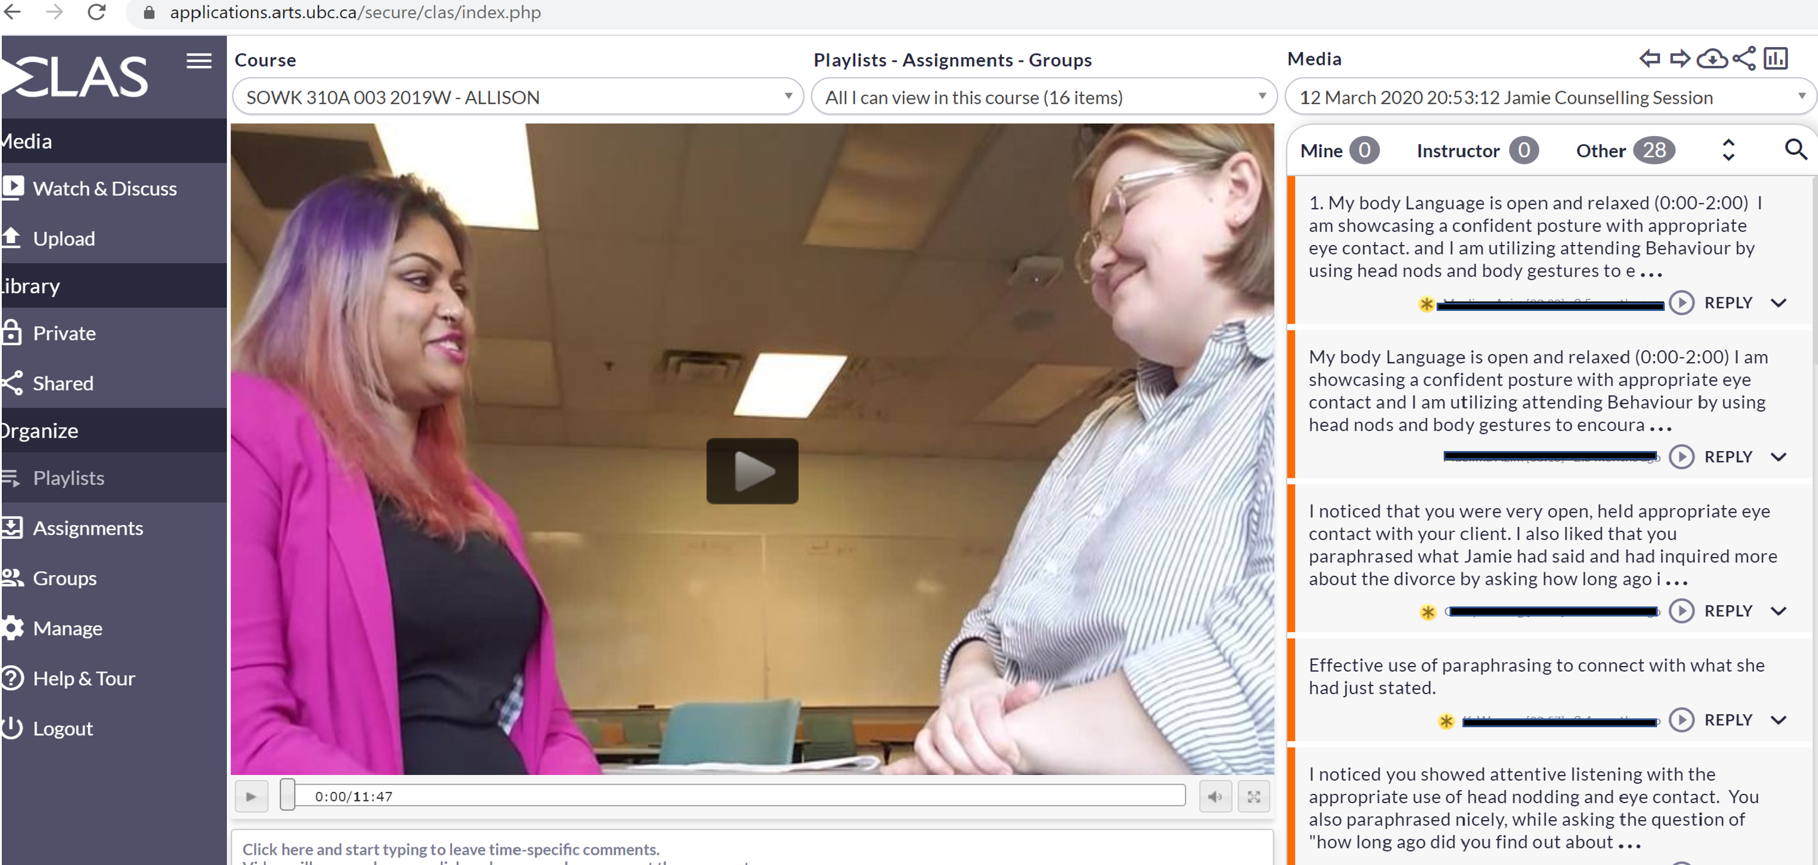
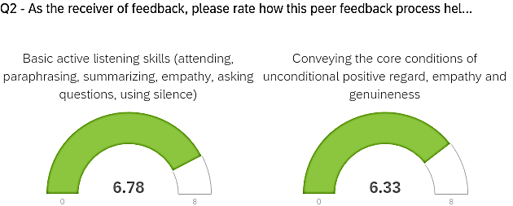
School of Social Work
Investigating the Impact of Peer Feedback on Communication Skills
Kelly Allison, MSW, Marie Nightbird, MSW, Grant Charles, PhD
A
n Collaborators
Research Question
Does a peer feedback process enhance learning of communication skills for social work students?
We also wanted to know:
Is written feedback better than verbal feedback?
What aspect of the feedback process helps?
Background
Interpersonal communication skills are central to effective social work practice. Social workers use these skills to establish effective and respectful working relationships. When working with service users, social workers use these skill to assess and make sense of complex situations and for decision making and intervention planning. Consequently, core communication skills such as active listening, paraphrasing and summarizing to convey understanding, empathic responses to attune to emotions and asking effective questions are all essential communication skills for social work students to learn.
Students have told us that the informal verbal peer feedback they received during their practice sessions was helpful in their learning, but we had never studied this formally.
Method
This research took place in three sections of a 3rd year Bachelor of Social Work Class involving 52 students in total.
Step 1: Students were taught how to provide constructive verbal feedback to their peers about their developing interpersonal communication skills using guidelines for peer feedback.
Step 2: Each week, students had opportunities to practice their communication skills and give verbal feedback to each other using the feedback guide.
Step 3: In term two, students were asked to complete a written peer feedback assignment. They uploaded a 10 minute practice video to CLAS (Collaborative Learning Annotation System) and provided written feedback on both their own mock counselling video and the video of 3 of their peers using the same feedback guide. Each student was then asked to write a reflection on how this written feedback will be integrated into their communication skill development.
Step 4: Students were surveyed regarding their learning from the CLAS written feedback assignment.
Results
85.1% of respondents agreed that receiving written peer feedback was helpful in improving communication skills.
76.6% of respondents agreed that giving written peer feedback was helpful in improving communication skills.
77.7 % of respondents agreed that self reflecting on how to integrate the feedback was helpful.
Conclusion and Implications
A peer feedback process enhances learning of communication skills
Giving, receiving and reflecting on feedback are all helpful components of the feedback process
A 10 min video was only useful for 1st term skills
Inconclusive results whether written is more advantageous than verbal peer feedback
More research investigating verbal peer feedback is needed
Reference / Bibliography
Boud,D., Cohen, R. & Sampson,J. (1999) Peer Learning and Assessment. Assessment & Evaluation in Higher Education, 24:4, 413-426, http://dx.doi/10.1080/0260293990240405
Butler, D., & Winne, P. (1995). Feedback and self-regulated learning: A theoretical synthesis. Review of Educational Research, 65(3), 245-281. http://dx.doi.org/10.3102/00346543065003245
Cameron, N. & McMillan, R. (2006) Enhancing communication skills by peer review of consultation Videos, Education for Primary Care, 17:1, 40-48. http://dx.doi.org/10.1080/1475990X.2006.11493509
Cheng, W. & Warren, M. (2000). Making a difference: Using peers to assess individual student's contributions to a group project. Teaching in higher education (5)2, 243-255. https://doi.org/10.1080/135625100114885
Dochy, F. J. R. C., Segers, M., & Sluijsmans, D. (1999). The use of self-, peer and co-assessment in higher education: A review. Studies in Higher Education, 24(3), 331-350. http://dx.doi.org/10.1080/03075079912331379935
Liu, N. F., & Carless, D. (2006). Peer feedback: The learning element of peer assessment. Teaching in Higher education, 11(3), 279-290. http://dx.doi.org/10.1080/13562510600680582
Acknowledgement
This project takes place on the traditional, ancestral and unceded territory of the Musqueam People.
We would like to thank the Sotl Seed Program and our Sotl facilitator Bruce Moghtader for his support and guidance on this project.
.
Partners
)

